Slide 1

Machine Learning–Based Error Classification
Intelligent Error Debugging for C++ and Python
Team Members:
Abiram Krishna (24CSB1A02)
Aditya Madhu (24CSB1A03)
Sanjay Rao (24CSB1A57)
Programming errors are a significant challenge for both learners and seasoned developers. This project introduces an innovative solution: using Machine Learning (ML) to automatically classify programming errors. Our system aims to make debugging faster, smarter, and more intuitive.
Our goal is to develop a robust model that can read an error message, comprehend its nature, and accurately predict its category for both Python and C++ codebases.

Slide 2

🎯 Project Benefits & Impact
Accelerated Debugging
Enhanced Learning
Dual Language Support
Automatically categorizes errors, reducing manual identification time. This allows developers to spend less time pinpointing issues and more time on core development, boosting productivity and project timelines.
Helps developers understand the root cause of errors, fostering better programming practices. For students, this translates into a more intuitive and less frustrating learning experience, promoting deeper comprehension of coding logic.
Capable of analyzing error messages from both C++ and Python. This broad applicability makes the tool versatile and invaluable for a wide range of programming environments and educational curricula.
Team Contributions
Abiram Krishna (24CSB1A02) - Frontend Development & Dataset Creation: Built the main user interface and visualization dashboard in app.py. Created the project's data foundation by writing generate_python_error_dataset.py to generate synthetic training data and clean_dataset.py to ensure data quality.
Aditya Madhu (24CSB1A03) - Core Machine Learning: Designed the primary machine learning logic within error_classifier.py. Implemented the NLP pipeline to process text and the TF-IDF system to extract features from the code errors.
Sanjay Rao (24CSB1A57) - Backend & Model Training: Developed analyzers.py to handle the compilation and execution of C++ and Python code(acts as the codes lexical analyzer and preprocess text). Created the mlbec3.py script that manages the model training process (Linear SVC) and saves the final system for use.
This innovative solution dramatically improves the current debugging process by providing immediate, intelligent insights into error types. It empowers developers to fix bugs more efficiently and helps students gain a clearer understanding of complex programming concepts, ultimately leading to higher quality code and a more effective learning curve.

Slide 3
Architecture & Methodology
From Data to Prediction: Our ML Pipeline
Our project follows a comprehensive workflow, from generating datasets to deploying a functional demo application. This systematic approach ensures accuracy and efficiency in error classification.
01
02
03
Dataset Generation
Model Training
FrontEnd StreamLit
Manually curated C++ errors (850+) and dynamically generated Python errors (750+), meticulously labeled for training.
Converts text-based error messages into numerical features, highlighting significant terms for ML models
Uses a streamlit interface to run our program locally, allowing us to check errors present within day to day codes
04
Models Used:
Separate models for C++ and Python are trained using algorithms like Logistic Regression, SVM, Random Forest, and Multi-nomial Naive Bayes, leveraging cross-validation for optimal accuracy.

Slide 4
Deployment & Implementation
Our final phase brings the Machine Learning-Based Error Classification system to life, focusing on robust deployment and practical application. This stage ensures that the insights from our trained models are readily accessible and actionable for developers.
01
02
03
Model Saving (.pkl files)
Error Analysis
Demo Application
Trained models are saved as .pkl files for persistent storage and instant loading, eliminating the need for retraining.
The system loads .pkl models to predict error types and confidence scores, providing detailed insights into compiler or runtime issues.
A user-friendly interface allows real-time input of C++ or Python code, displaying predicted error categories and confidence levels.
The use of .pkl files is crucial, acting as the 'brains' of our classifier by storing trained models and TF-IDF vectorizers for rapid error classification.
In practice, our system integrates seamlessly into a developer's workflow. Users can simply paste their problematic code snippets or error messages into the demo application. The backend then processes this input using the pre-trained models, identifying the error type and providing a confidence score. This real-time feedback loop significantly reduces debugging time and enhances code quality by offering immediate, intelligent insights.

Slide 5






Novelty & Improvements
Pioneering the Future of Error Classification
Our project introduces several unique aspects that significantly enhance traditional error handling, offering substantial improvements over standard approaches.
Dual Language Support
Dataset Creation
Seamlessly classifies errors in both C++ and Python.
Efficient generation of realistic Python error datasets saves invaluable time.
Unified Cleaning System
Persistent Models
A single script for data cleaning across multiple languages.
.pkl files enable instant reuse of trained models without retraining.
Confidence-Based Results
Modular Design
Provides prediction confidence and probability scores for all classes.
Independent pipeline components allow for flexible development and testing.

Slide 6
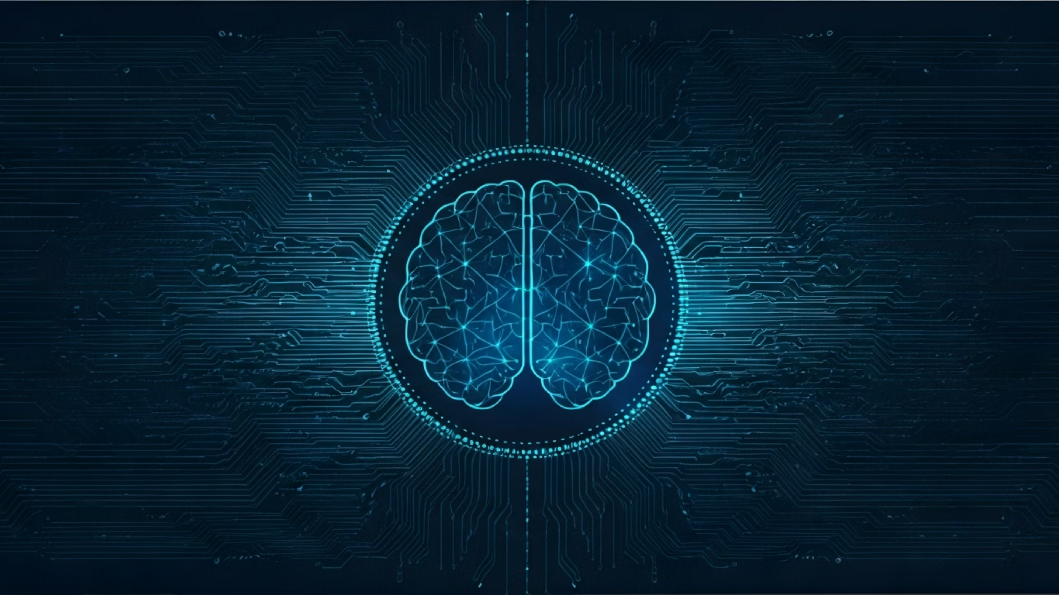
Future Scope & Vision
We envision expanding the system to support more languages, integrating advanced NLP models like BERT, and developing AI-driven error correction suggestions using LLMs.
Future Enhancements:
More Languages
Advanced NLP
AI Correction
Extend support to Java, JavaScript, and C#.
Implement transformer-based models for enhanced accuracy.
Integrate LLMs for intelligent error correction suggestions.
"From error text to intelligent classification — one project, two languages, endless possibilities." 💡
Our long-term vision for this system extends beyond mere classification. We foresee its evolution into an intelligent coding assistant, capable of proactively identifying potential issues before compilation, suggesting optimized code snippets, and even generating complete solutions for common errors. This technology could revolutionize coding education by providing personalized, context-aware feedback, accelerating learning curves for aspiring developers. In professional environments, it promises to significantly reduce debugging cycles, enhance code quality, and free up developers to focus on innovation rather than troubleshooting. The continuous advancement of AI, particularly in natural language understanding and generation, will be pivotal in realizing this vision, making programming more accessible, efficient, and enjoyable for everyone.

